Slide 1

Critical Thinking Skills
Lecture: Critical Thinking and Media

Slide 2
Objectives:
Students should be able to
Define mass media and social media
Identify the importance of context in the news media
Identify advertisement techniques

Slide 3
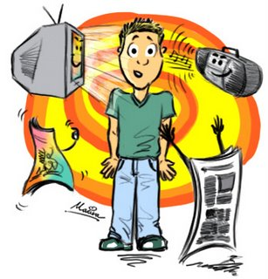
We live today in the “information age”.
Throughout the day we are bombarded with information from radio, television, computers, newspapers, books, magazines, phones, message boards, signs, and billboards.

Slide 4
Mass Media and Social Media
Mass media
a general term, encompassing all media outlets (networks, stations, publications) that produce and deliver content intended to inform, entertain, or persuade the largest possible audience
Sony Pictures, CNN, USA Today, Cosmopolitan, Time
Include broadcast, print, movie, recording industries, novels, textbooks, news, sports reports, soap operas, editorials

Slide 5
Mass Media and Social Media
Social media
Technology (or method) through which formerly passive consumers produce and share information on publicly accessible websites that permit social networking
Users can follow and communicate with one another, work collaboratively on projects and recommend content to other users.
Mass Media | Social Media
Audience is passive | Audience is interactive

Slide 6
Echo Chamber (Common Pitfalls)
Echo chamber effect results from the tendency among some social media users to believe and repeat a set of ideas and information that is never challenged or questioned.
Eg: COVID-19 pandemic
Unchallenged rumours and misinformation could lead to risky behavior and put the lives of those in the echo chamber at greater risk.

Slide 7
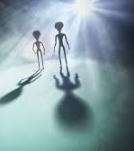
Echo Chamber (Common Pitfalls)
Confirmation bias
The tendency to seek and uncritically trust any new information that confirms one’s existing beliefs or opinions, and to disregard any information that challenges them.
Eg: Aliens occasionally visit Earth
When using social media to find evidence to validate an opinion or belief, be extra cautious with information that seems immediately to prove you right.
If you find yourself saying, “See! I knew it!” you may not be thinking very critically.

Slide 8

Echo Chamber (Common Pitfalls)
Inappropriate Appeal to Authority
Solutions:
Look for advice on especially vital issues such as health, relationships, and finances
Don’t immediately accept someone’s suggestions or diagnosis.
Avoid confirmation bias
Do further research

Slide 9
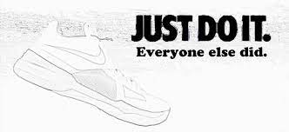
Echo Chamber (Common Pitfalls)
Bandwagon
Solutions:
Be skeptical
Read carefully the information provided
Consider extending your investigation to traditional media sources before lending your name or forwarding information to your friends
Resist the urge to encourage or “like” or pass along gossip and character assassinations.

Slide 10
The News
News
information about current events in a wide range of categories.
Politics, economics, sports, entertainment, culture, world affairs, technology
News media
Any person or organization, usually a branch of the mass media, that regularly delivers news through television, newspapers, magazines, radio, or the Internet
These people or organization, act as MIDDLE agents to connect us to the world of events occurring all around us but beyond our ability to experience firsthand.
Through the lens of someone’s else eyes, language, camera lens.

Slide 11
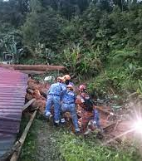
The News
As critical thinker, analyze and evaluate the news media by asking TWO basic questions.
What actually happened?
what exactly are the uncontroversial fact of the matter?
Who was involved?
When and where did it happen?
What precisely was said by those involved?
What precisely did authorities, experts, witnesses say about the event?
How is the event being presented to an audience?
Who is telling the story?
In what form?
Through what technological devices?
In what tone and style?
With what word choices?
What has been left out of the whole story?
What has been added?
What has been emphasized?
What in the story reveals the perspective of the writer or reporter?
How would the story be different if told from another point of view

Slide 12
The News
We also turn to news for opinions.
In evaluating such content from the news media, we apply the basic questions of critical thinking:
Are arguments in the news media based on true premises and good reasoning?
Has the writer or speaker ignored or twisted facts to defend a claim?
What assumptions underlie the argument?
Is the argument logical?
Are competing interpretations and explanations explored
4 steps to critically analyze the media’s presentation of information.
Compare sources
Consider the context
Look at how information is arranged
Evaluate the language

Slide 13
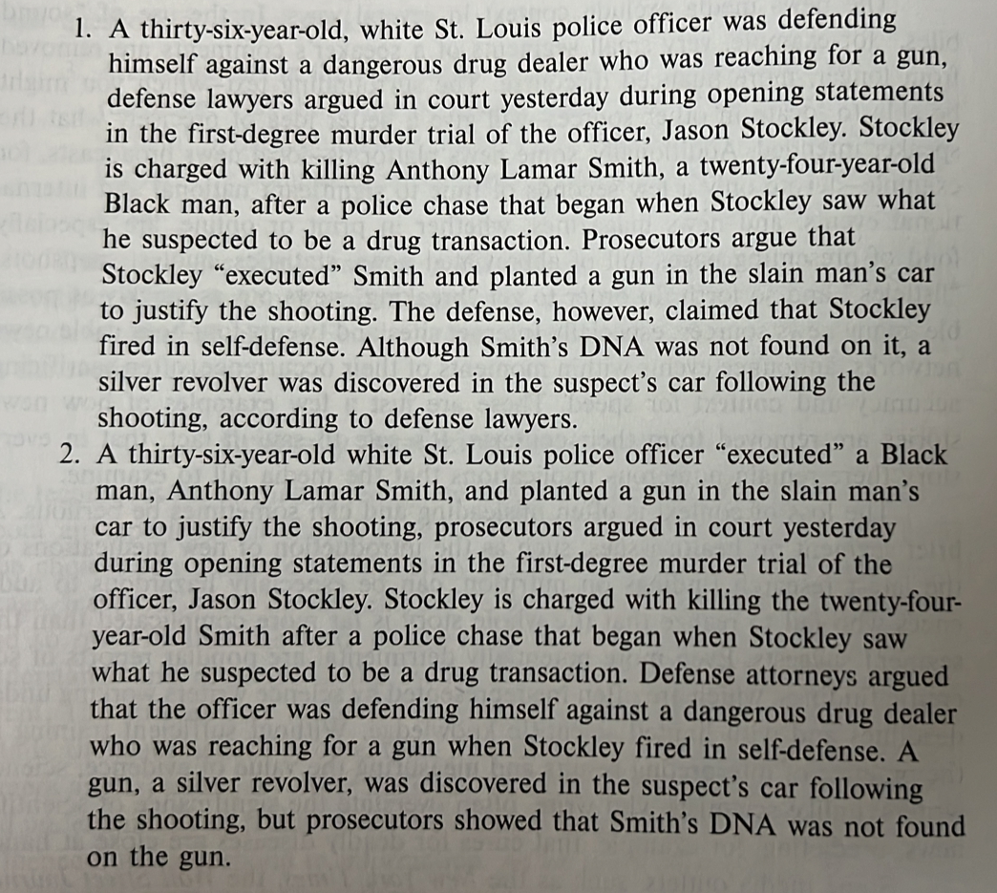
Compare the paragraphs

Slide 14
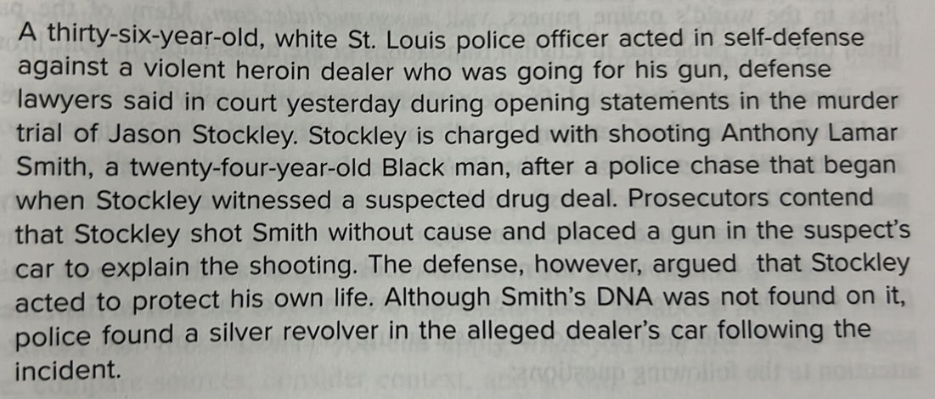
Compare the paragraphs

Slide 15


5 Strategies for Spotting Fake News
Look
Look closely at the headline
Find out
Find out what you can about the source
Examine
Examine all “evidence” provided in the story
Research
Research what others have said about the story
Think about
Think about the intended audience-including yourself.

Slide 16
Advertising

Slide 17
Advertising
As we have seen, the media have a great influence on our beliefs and values.
Television, newspaper, radio, billboards, and the Internet inject their influence into every aspect of our lives; and advertising, using these media, is a pervasive, powerful force shaping attitudes and behavior in today’s world.

Slide 18
What Ads Do
Advertisements have two basic functions: to inform and to motivate. Sometimes these two functions support each another, but often they do not. A good ad is truthful, informative, and persuasive.
The point of studying advertising ploys and strategies is to become a more critical, insightful, and selective consumer of the barrage of advertising appeals we experience.

Slide 19

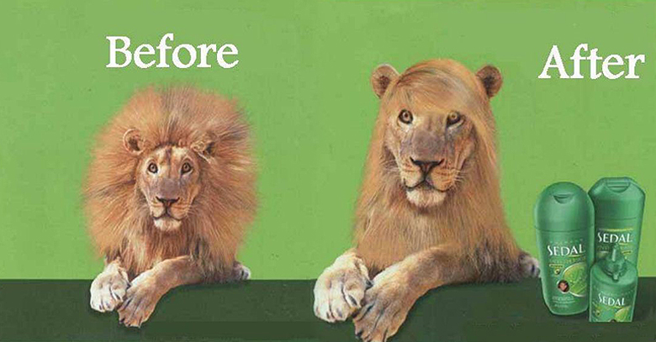


Strategies/ploys used in advertisements
the use of humor;
2. the use of catchy slogans and jingles;

Slide 20
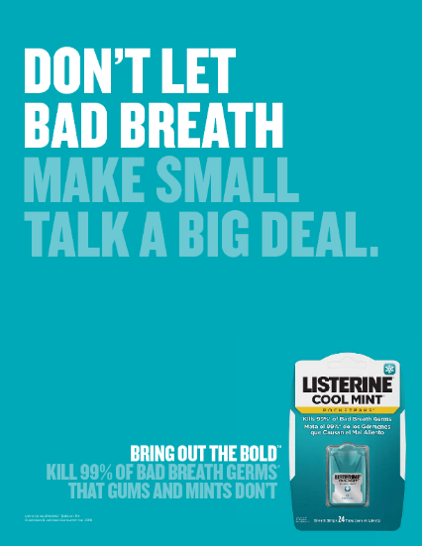
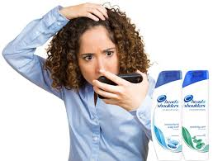

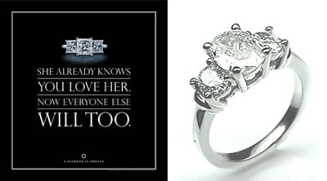
Strategies/ploys used in advertisements
3. Anxiety ads
4. the use of emotive words;

Slide 21

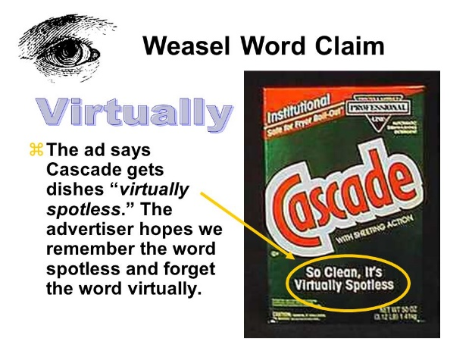
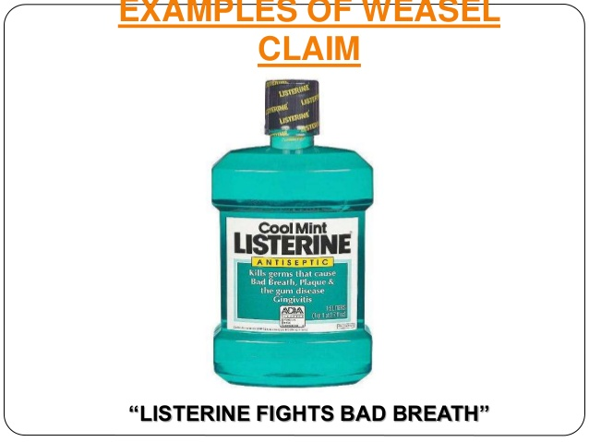






Strategies/ploys used in advertisements
5. the use of weasel words;
6. the use of fine-print disclaimers;

Slide 22
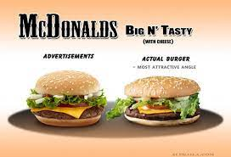



Strategies used in advertisements
7. the use of puffery;
8. the use of sex appeals;

Slide 23
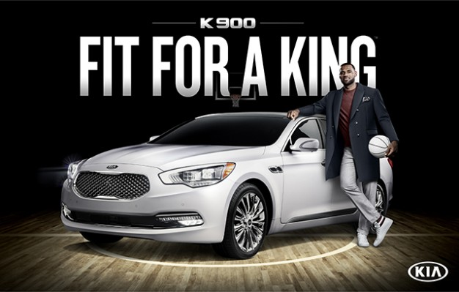

Strategies/ploys used in advertisements
9. the portrayal of enviable situations and enviable people;

Slide 24
Tutorial

Slide 25
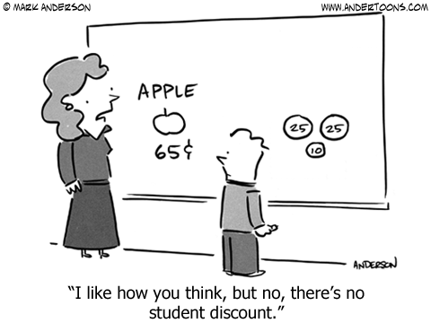
Identifying Common Advertising Ploys
This tutorial provides practice in identifying five common advertising ploys: fear of rejection, humor, catchy slogans and jingles, puffery, and the promise of sex.

Slide 26
Sample Question
Always scratching your head? Your date may be watching. That's an immediate turn-off! Protect yourself. Before your next important date use Dandrex Dandruff Shampoo Plus Conditioner.
Based on what you learned in this chapter, which advertising ploy does this ad use? Anxiety ad

Slide 27

Sample Question
"I love Don”. That's what the tattoo reads. The guy getting it wanted it to read "I love Donna" but he didn't have enough cash on hand. The last scene of this TV ad shows his girlfriend, Donna, walking out on him. The voice-over says, "Next time be ready for such an emergency. Get VISA."
What advertising ploy does this ad use?
Humour

Slide 28
Sample Question
We've spent the last six months thinking about your love life. Because we know you haven't had the time. But now, it's time for you. Time for holding hands, stealing kisses, and sharing secrets. How about this weekend? A beautiful room and fabulous breakfasts are just the start of our romantic weekend packages. (Ad for Marriott Hotels)
What advertising ploy does this ad use?
The use of sex appeals

Slide 29
Sample Question
"Why wash away the day, when you can wash away the years?" (Ad for Olay Cleansing Cloths)
"Beyond words." (Ad for Rodney Strong Cabernet Sauvignon wine)
"Springtime every time you do dishes." (Ad for Palmolive Dishwasher Detergent)
What advertising ploy does this ad use?
Puffery

Slide 30
Sample Question
"Sony, the one and only"
"Good to the last drop"
"Build a style that's all your own."
"Tastes great, less filling"
What advertising ploy does this ad use?
Catchy slogan and jingles

Slide 31
Tutorial
Choose an advertisement that you found on a newspaper/magazine (online@ offline)
a. Identify TWO (2) inappropriate persuasion techniques from the advertisment above. Explain your answers.
b. Based on this advertisement, what elements or components can be improved? Provide two (2) recommendations.

Slide 32
The End

